Slide 1
Car Plate Vehicle Number Recognition
Presented by
Wahyu Rahmaniar
102521604

Slide 2
Motivation
Number plates are used for identification of vehicles all over the nations
Number plates vehicles are identifying either manually or automatically
Automatic vehicle identification is an image processing technique of identify vehicles by their number plates.

Slide 3
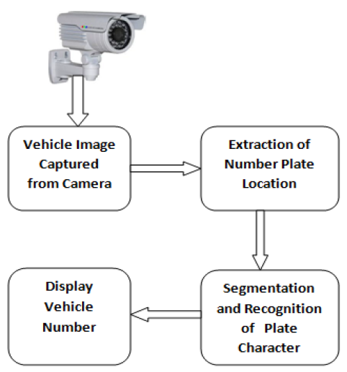
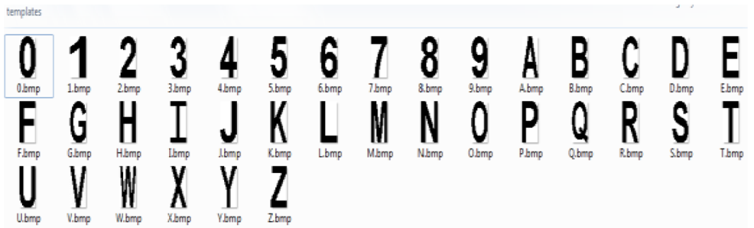
RECOGNITION OF VEHICLE NUMBER PLATE USING MATLAB (Ragini Bhat, Bijender Mehandia)
This paper using camera to get the picture of vehicle
Extract and find the location of the plate number
Segmented the character in the plate number using bounding box
Recognition the character using template of 42x24 pixels of alphanumeric database
Fig 1. Block Diagram of Previous Work
Fig 2. Template of Alphanumeric Database

Slide 4
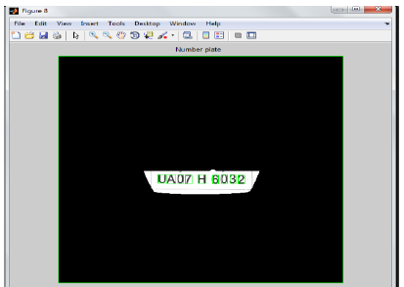

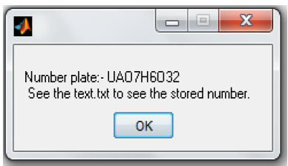
Result of Previous Work
(a)
(b)
(c)
Fig 3.(a) Result of Plate Number Extraction. (b) Result of Character Segmentation. (c) Result of Character Recognition

Slide 5
Block Diagram System
Input Image
BW image
Cropping
Segmentation
Scaling
Recognition
Fig 4. Block Diagram Proposed System

Slide 6
Black and White Image
Input image is RGB image and resize to 700x300 pixels
Change input image into black and white color
Input Image
Read RGB value of pixel
(R+G+B) > 128?
R = 255
G = 255
B = 255
R = 0
G = 0
B = 0
Change pixel value
Fig 5. Black and White Image Flowchart

Slide 7
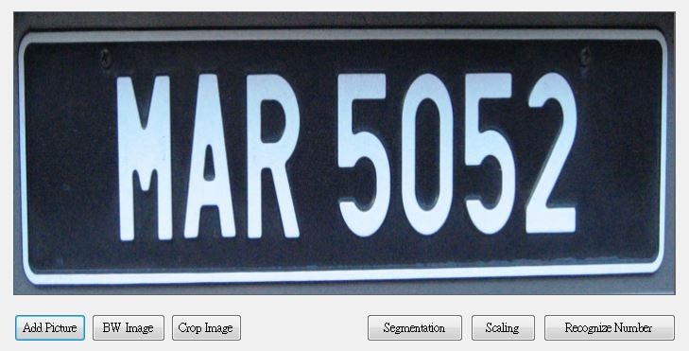
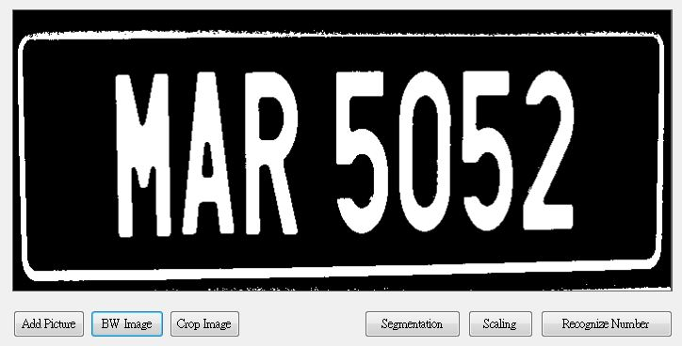
Black and White Result
Fig 6. Read Image Result
Fig 7. Black and White Image Result

Slide 8
Cropping Image
Input Image
Image cropped with 2 steps
First: image crop with subtraction pixel of width and height of image
Second: image crop base don outer pixel value location
Crop image:
Width = width – 60
Height = height - 40
Read pixel value
Crop image based on outer white pixel
Fig 8. Crop Image Flowchart

Slide 9

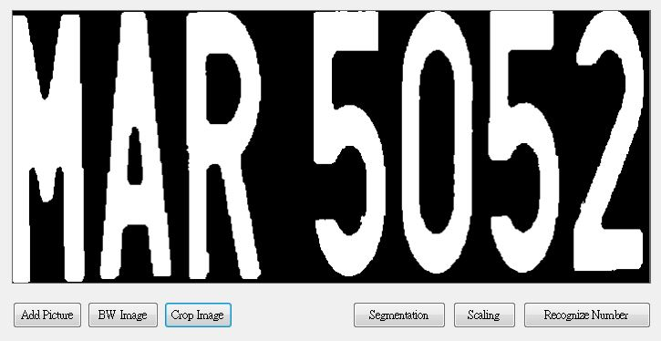
Crop Image Result
(a)
(b)
Fig 9. (a) Crop Image Result 1. (b) Crop Image Result 2

Slide 10
Segmentation
Input Image
Read RGB value of pixel
First: find the leftmost white pixel than mark it as minimum location to crop
Second: find the pixel that contain of full black pixel value in one column (it’s mean one vertical line) as maximum location
Then crop image based on minimum and maximum location
We got one character result
Find the leftmost white pixel in the image (minimum)
Find the location that contain of full black pixel in one column (maximum)
Crop image from minimum to maximum (find character)
Fig 10. Segmentation Flowchart

Slide 11




Some Problem in Segmentation
After we crop the character from image, then we got the result of character and original image as below:
In order to make the segmentation easier, we need to crop image based on the leftmost white pixel value
But, sometimes the cropping is not correct as below:
Then, we need to check the first column. If it not contain of black pixel it’s mean the cropping is not correct, so we need to crop it again.
And sometimes image contain of small white pixel that disturbed the cropping process as below:

Slide 12

Some Problem in Segmentation
If the cropping of image is not correct, then we will got the wrong segmentation as below :
Then, we need to check the segmentation box, if it’s contain of black line vertical it’s mean wrong segmentation
We need to crop the original image again than repeat the segmentation

Slide 13
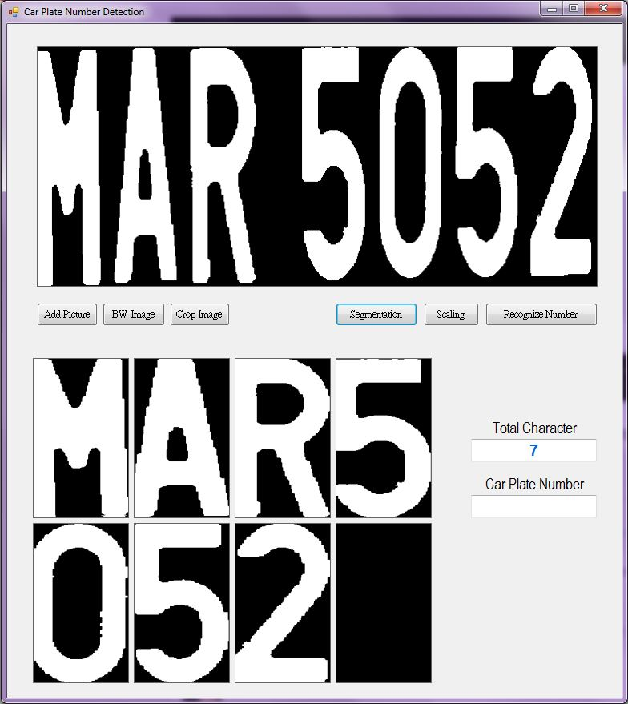
Segmentation Result
Total character count based on the successful segmentation result.
If the segmentation contain of some white pixel then count it as character
Fig 10. Segmentation Image Result

Slide 14

Scaling Image
Before we recognize the character, we need to change the scale of character image into 10x15 pixels
Scale image using bicubic interpolation
Then invert the color, because it will be easier to find the black pixel character
Fig 11. Scaling Image Result

Slide 15
Video Result

Slide 16

Next Progress
Next, we will recognize character base don character template of 10x15 pixels as below:
Then matching image to every template and find the biggest percentage result.

Slide 17
References
R. Bhat and B. Mehandia, “Recognition of Vehicle Number Plate using Matlab”, International Journal of Innovative Research in Electrical, Electronics, Instrumentation and Control Engineering, Vol. 2, Issue 8, August 2014

Slide 18
Q&A
Q&A

